Slide 1


CSE240
Introduction to Programming Languages
Chapter 1
Common Aspects of Programming
Languages
Lecture 03
Structure and Error Types
Reading: Textbook Section 1.2
Yinong Chen

Slide 2
The Structure of Programs
How do we express programs, and what do they mean?
Different levels of analyses:
lexical:
begin … end, { ... }, ;
syntactic:
if … then … else …, switch, for ... do
contextual:
variable, type, name, initialization, etc.
semantic:
meaning and behavior of a program

Slide 3
Program Structure: Lexical
Lexical symbols, units, tokens: basic building blocks.
Identifiers: Names (programmer chosen) of objects of interest (variables, procedure names etc.). Issues: length, case sensitivity, allowable characters, special rules.
Keywords: names reserved by the language designer: if, else, switch, int, float, char
Operators: +, *, <<, >=, !, &&, ||,
Separators: , ; . ( ) etc.
Literals: numbers, characters, strings
Comments: /* ... */, // ...
Layout, space: some languages are of free format, while some are not, e.g., Python.

Slide 4
Program Structure: Syntactic
Syntax of language describes how to put lexical units together to form valid sentences/statements.
In the late 1950s, a concise and formal way of expressing syntax was introduced: Backus-Naur Form (BNF).
BNF: Meta-language for describing languages, context free language:
non-terminal symbol: symbols in grammar — They do not appear in final program;
terminal symbol: symbols that appear in actual programs — go no further in translating from grammar.

Slide 5
Program Structure: Syntactic
Example: Define a Very Simple Language (VSL)
<sentence> ::= <subject> <verb> <object>
<subject> ::= <adjective> <noun>
<adjective> ::= <adjective> | <adjective> <adjective>
<object> ::= <subject>
<noun> ::= table | horse | computer
<adjective> ::= big | fast | good | high
<verb> ::= is | makes
<sentence> ::= <verb> <subject> <object> ?
| <noun>
| <adjective>
fast big high horse is good
big high table is good table
high is computer
horse eats grass
table makes horse
fast table is high
is fast computer good
is fast computer good?

Slide 6
Program Structure: Syntactic
Example: Define a Very Simple Programming Language (VSPL)
<char> ::= a | b | c | … | z | 0 | 1 | ... | 9
<operator> ::= + | - | * | / | % | < | > | == | ≤ | ≥
<variable> ::= <char> | <char> < variable>
< expr > ::= < variable> <operator><variable>
| ( <expr> ) <operator> ( <expr> )
<assign> ::= < variable> = <expr>;
<statements> ::= <assign> | <assign> <statements>
Which are valid?
2sum = 2+3;
sum4 = (a1 + a2) * (3b % 4*b);
3p4rd2 = ((1a + a2) * (b3 % b4)) / (c7 - c8);
foo_bar = (a1 + a2 - b3 - b4);
(a1 / a2) = (c3 - c4);

Slide 7
Program Structure: Syntactic
A language can also be defined by a syntax graph
if (condition) statements ;
else statements ;
if (a < 0) return -a;
if (a < 0) return -a; else return a;
switch (expr) { case value: statements ;
}
default: statements;
switch (ch) {
case '+': x = a + b; break;
case '-': x = a - b; break;
case '*': x = a * b; break;
case '÷': x = a / b; x = round(x); break;
default: printf("invalid operator"); break;
}

Slide 8
What is the syntax graph of the "while (condition) do {statements;}"?
(A) while (condition) do {statements;}
(B) while (condition) do {statements;}
(C) while (condition) do {statements ;}
(D) while (condition) do {statements ;}
(E) while (condition) do {statements ;}

Slide 9
Program Structure: Syntactic
What is the syntax graph for a “for loop”?
for ( <init-expr>; <test-expr>; <increment-expr> )
{
<statements>
}
(E)
for ( <init-expr>; <test-expr>; <increment-expr> ) {<statements>}
(C)
(D)
(B)
(A)

Slide 10
Syntax Graph Case Study JSON (JavaScript Object Notation) Data Definition Using Syntax Graph
<number>
<string>
<object>
value
<array>
true
false
null

Slide 11
JSON Number and Object Format
number
0
.
<digit>
-
e
E
+
<digit1-9>
<digit>
<digit>
-
object
{
<string>
:
<value>
}
,
Object Example
{"name":"John Doe", "age":25, "married":true, "University":"ASU", "Graduated":false, "Courses":{"CSE240":200,"CSE310":300,"CSE446":400, "GPA":3.75}}

Slide 12
JSON Array
array
[
<value>
]
,
Array of string
["John Doe", “Mary", "Smith"]
Array of
mixed values
[{"John Doe":25}, {"Mary":30}, "Smith", 20, true]
Array of arrays
[
[1, 2, 3, 4],
[2, 3, 4, 5],
[5, 2, 3, 5]
]

Slide 13
Program Structure: Contextual
Contextual (Static Semantics) structure usually defines the semantics before dynamic execution, e.g., variable initialization and typing. Type consistency is usually checked by typing rules.
string str = “abc”; int i;
i = 1 + str;
The declaration and assignment are syntactically correct,
but the assignment statement is contextually incorrect.
What can a compiler do:
(1) Lexical, (2) syntactic and (3) contextual checks, but not semantic checks

Slide 14
Program Structure: Semantic
Semantics describes the meaning of a program. Semantic errors cannot be detected by compiler, e.g.
int x = 0; int x = 0, y, z;
int y = 5; x = 3;
int z = y / x; y = 5;
z = y/(y-x-2);
What type of error if declaration is missing?
Could be implemented as
int z;
z = y/x;
- Lexical
- Syntactic
- Contextual
- Semantic
No formal definition for imperative and OO languages.
Functional programming languages have formal semantic definition based on the mathematics used. See text section 4.5 (lambda calculus), which will be taught in CSE340.
In logic programming languages, logic expressions is often used for describing the semantics.
Semantic languages: e.g., Prolog, RDF (Resource Description Framework) and OWL (Web Ontology Language)

Slide 15
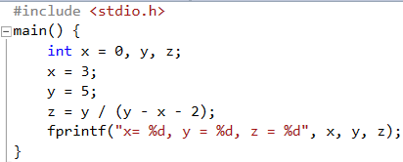
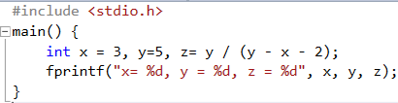

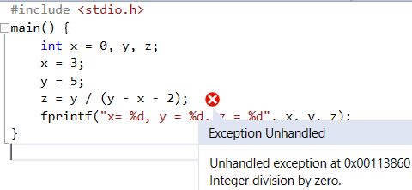
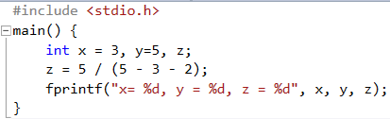

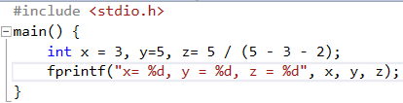



Examples of Contextual and Semantic Errors
(a)
Contextual error
in initialization
(c)
Declaration
Execution
Execution
GCC & VS pass compilation
(b)
Certainly pass compilation
Semantic error when executing
(e)
Semantic error when executing
(d)
Contextual error
in initialization
Visual Studio

Slide 16
Error Type Summary
Lexical errors: Errors at the lexical level. Compiler can detect all of them;
Syntactical errors: Errors at the syntactic level. Compiler can detect all of them;
Contextual errors: Errors at the contextual level. They include all the errors in variable declaration, variable initialization, and type inconsistent in assignment. Compiler implementations may or may not detect all the initialization errors, depending on if they actually compute the initialization expression or not. For example: int x = 5/(3+2); // contextual error compiler may not detect
Semantic errors: Errors at the semantic level. They include all the errors in the statements that will be executed after passing compilation. For example: int x; x = 5/(3+2);

